Slide 1
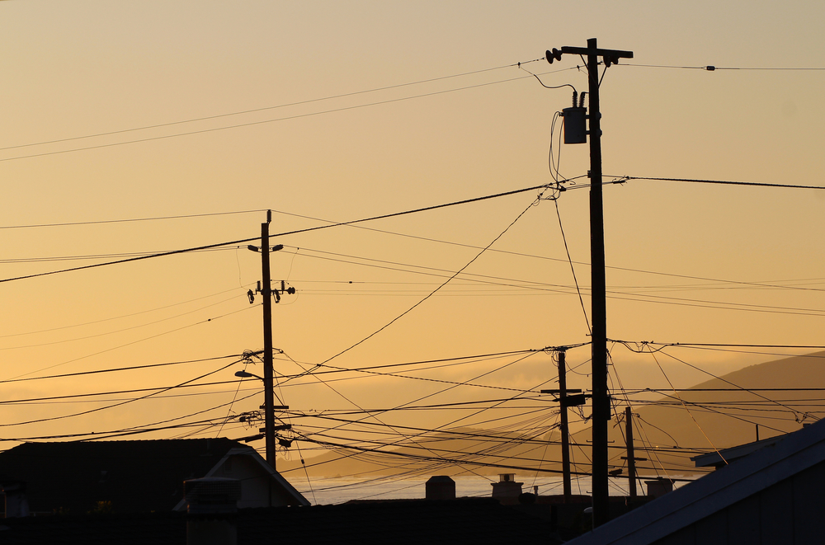


VIRGINIA USER GROUP MEETING
March 4, 2025

Slide 2
DIRECTORS
Beth Harris – Dominion Virginia Power beth.harris@dominionenergy.com 540-245-4123

Slide 3
PT+ USAGE
Steps
Created
Closed
12MM
12MM
PY
TY
YTD
YTD
% Chg
2024
2025
% Chg
Total Open Tickets: 50,720
Draft Tickets: 9,991
Ready to Close: 4,380 (all steps completed)
Tickets Created 10,965 9,136 -17% 1,777 1,307 -26%
Tickets Closed 6,294 6,147 -2% 1,194 985 -18%
Tickets w/ Steps Completed: 14,111 14,867 5% 2,403 3,010 25%

Slide 4
PA USAGE
12MM
2024
2025
% Chg
Tickets Created 1,992 581 187 -67%
Tickets Closed 41 2 2 0%
Open Tickets: 16,291 / Draft Tickets: 1,269

Slide 5
TOP 5 USERS (12MM)
Top Creators (PT)
Dominion Energy
Verizon
American Electric Power
Shenandoah Valley Electric Cooperative
Northern Virginia Electric Cooperative
Top Updaters (PT)
Verizon
Entergy
Dominion Energy
Comcast
Cox Communications
Top Owners (PA)
Dominion Energy
Shenandoah Valley Electric Cooperative
Rappahannock Electric Cooperative
A & N Electric Cooperative
Verizon
Active Users: 1,382
Active Member Codes: 254

Slide 6
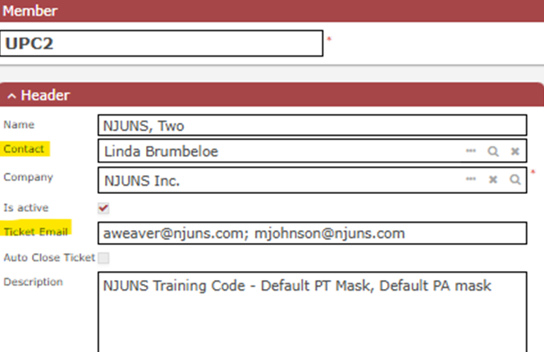
MEMBER CODES
View codes in profile by clicking on Members<My Members.
Run report called Member Codes By State.
Send any updates to support@njuns.com.
Ticket Email can have up to 4 email addresses. If blank, it will deactivate after several bounces.
Make sure Contact is correct and ticket email are correct.
Enable Auto-Close here to utilize feature.

Slide 7
TICKET TYPES
Ticket Type | 12MM
Pole Transfer | 3,713
Pole Replacement | 2,415
Pole Attachment | 1,992
Make Ready | 1,550
New | 607
Violation | 304
Other | 263
Pole Abandonment | 118
Pole Location Elimination | 66
Overlash | 26
Aerial Clearance Review | 10
Change of Ownership | 4
Joint Trench | 1
See Ticket Type Definitions document located under Training – Best Practices

Slide 8
DISPUTE REASONS
Dispute Reason | Quantity
Other | 701
Member Code Incorrect or Not Attached | 552
Previous Step Not Complete | 390
Unable to Locate or Bad Address | 166
Wrong Pole Owner | 141
Pole Owner Work Not Complete | 53
Add New Step | 43
Work Unnecessary | 42
Step Order Incorrect | 37
Duplicate Ticket or Step | 19
JU Transfer | 1
Transfer Step Not Complete | 1
TOTAL | 2,146
Approximately 2,146 active Dispute Steps
“Other” may have better choices:
- Can’t Locate Pole
(Use “Unable to Locate or Bad Address”
Not on Pole
(Use “Member Code Incorrect or Not Attached”)
CATV needs to Transfer First
(Use “Previous Step Not Complete or Add New Step”)

Slide 9


INFO & ACTION ITEMS
Visit Training tab on www.njuns.com for available training
Training Calendar, User Guide, Training Videos, Best Practices
Visit News tab on www.njuns.com for updates
Subscribe to our Newsletter on our website Home tab
Check for system Alerts on the NJUNS dashboard
Review Member Codes, Contacts and Ticket Email Recipients for updates
Close Tickets that are Ready to Close (have all steps completed)
Follow us on social media
Prepare for future user authentication
Send requests for assistance to support@njuns.com
LinkedIn
NJUNS, Inc.
X( formerly Twitter)
@NJUNSINC

Slide 10
SHORT DEMO
NJUNS Tips & Tricks
Utilizing the PT⁺ Detail Report
Review uses for Import Tool

Slide 11
QUESTIONS
Any questions for us?
Contact us at support@njuns.com
818-485-2765, ext. 1

