Slide 1
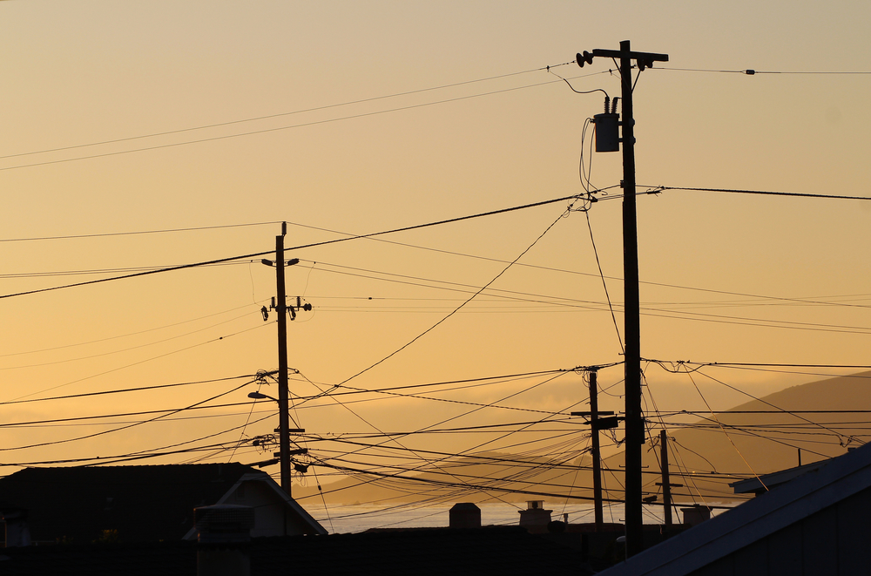


MISSOURI USER GROUP MEETING
March 11, 2025

Slide 2
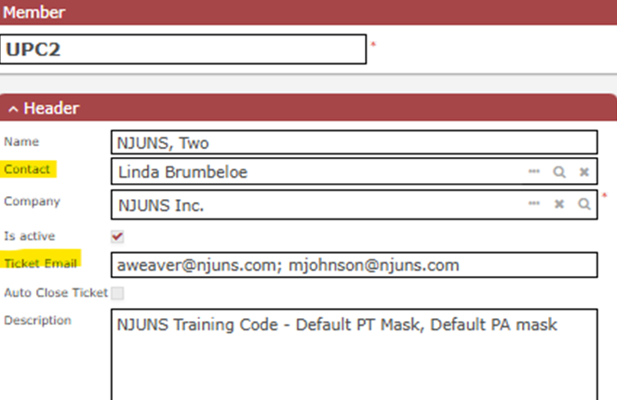
MEMBER CODES
      View codes in profile by clicking on Members<My Members.
      Run report called Member Codes By State.
      Send any updates to support@njuns.com.
      Ticket Email can have up to 4 email addresses. If blank, it will deactivate after several bounces.
      Make sure Contact is correct and ticket email are correct.
      Enable Auto-Close here to utilize feature.

Slide 3
TICKET TYPES (12MM)
Ticket Type | 12MM
Pole Transfer | 8,526
Make Ready | 406
Pole Replacement | 136
Violation | 115
Other | 82
Pole Attachment | 79
Overlash | 58
New | 49
Pole Location Elimination | 6
Pole Abandonment | 5
Aerial Clearance Review | 5
Change of Ownership | 2
Common Crew | 1
TOTAL | 9,470
See Ticket Type Definitions document located under Training – Best Practices

Slide 4
CURRENT DISPUTES
Dispute Reason | Quantity
Member Code Incorrect or Not Attached | 646
Duplicate Ticket or Step | 134
Other | 117
Pole Owner Work Not Complete | 72
Wrong Pole Owner | 62
Unable to Locate or Bad Address | 26
Previous Step Not Complete | 14
Work Unnecessary | 12
Step Order Incorrect | 7
TOTAL | 1,090
        Approximately 1,090 active Dispute Steps
“Other” may have better choices:
- Can’t Locate Pole
(Use “Unable to Locate or Bad Address”
Not on Pole
(Use “Member Code Incorrect or Not Attached”)
CATV needs to Transfer First
(Use “Previous Step Not Complete or Add New Step”)

Slide 5
DIRECTORS
Caleb Bandy - AT&T
cb255a@ATT.com
314-886-3344
Tina Steele - Evergy
tina.steele@evergy.com
816-245-4094

Slide 6
PT+ USAGE (2014 – 2024)
Steps
Open
Created
Closed
2024
2025
% Chg
YTD Tickets Created: 1,835 670 -67%
YTD Tickets Closed: 1,885 4,343 130%
YTD Tickets w/Steps Completed: 4,279 5,877 37%
Total Open Tickets: 82,757
Tickets with Steps Completed: 5,877
Ready to Close: 4,644 (all steps completed)

Slide 7
PA USAGE (2014 – 2024)
2024
2025
% Chg
Tickets Created: 15 23 53%
Tickets Closed: 1 0 -100%
Open Tickets: 1,264
Draft Tickets: 159

Slide 8
TOP 5 USERS (12MM)
Top Creators (PT)
Ameren Missouri
Evergy
City Utilities of Springfield
Kansas City Power and Light
City of Kirkwood
Top Updaters (PT)
Ameren Missouri
AT&T Southwest
Charter Communications
City Utilities of Springfield
Mediacom Communications
Top Owners (PA)
Liberty Utilities (Empire District) (49)
Evergy (30)
AT&T Southwest (1)
Active Users: 354
Active Member Codes: 234

Slide 9


INFO & ACTION ITEMS
Visit Training tab on www.njuns.com for available training
              Training Calendar, User Guide, Training Videos, Best Practices
              Visit News tab on www.njuns.com for updates
              Subscribe to our Newsletter on our website Home tab
Check for system Alerts on the NJUNS dashboard
Review Member Codes, Contacts and Ticket Email Recipients for updates
Close Tickets that are Ready to Close (have all steps completed)
Follow us on social media
Prepare for future user authentication
Send requests for assistance to support@njuns.com
LinkedIn
NJUNS, Inc.
X( formerly Twitter)
@NJUNSINC

Slide 10
SHORT DEMO
    NJUNS Tips & Tricks
      Utilizing the PT⁺ Detail Report
      Review uses for Import Tool

Slide 11
QUESTIONS
Any questions for us?
Contact us at support@njuns.com
818-485-2765, ext. 1

