Slide 1
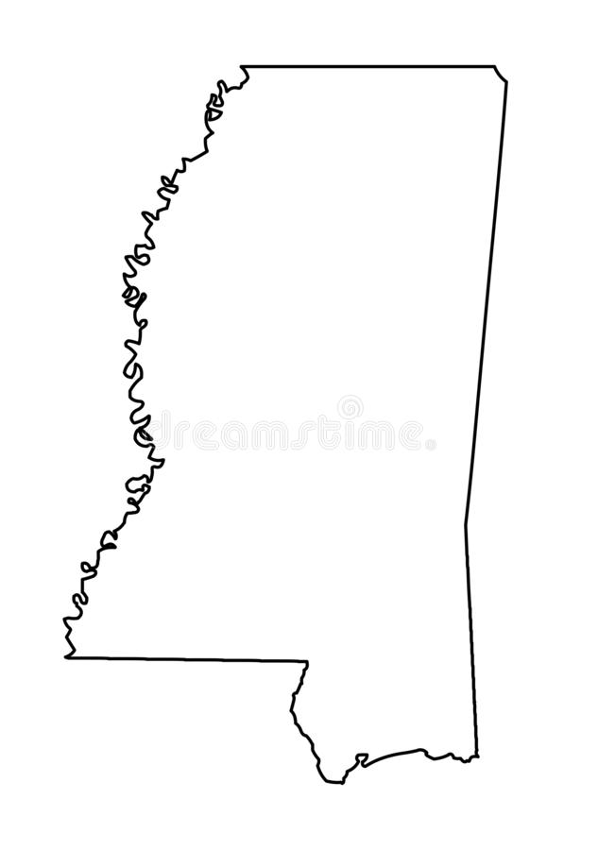
Mississippi User Group Meeting
Thursday, Jan. 26, 2023

Slide 2
PT + Usage
2021 Jan-Dec
Created: 4,806
Closed: 1,850
Tickets w/ Steps
Completed: 6,113
2022 Jan-Dec
Created: 4,735
Closed: 1,592
Tickets w/ Steps
Completed: 6,189
** PT+ includes all Ticket Types except Attachment Request (PA)
Total Open Tickets: 23,756
Ready to Close: 2,737 (all steps completed)

Slide 3
Top 5 Users (2022)
Top Creators (PT)
Singing River EPA
Coast Electric Power Association
AT&T Southeast
Mississippi Power Company
Entergy
Top Updaters (PT)
AT&T Southeast
Mississippi Power Company
Cable ONE
Coast Electric Power Association
Entergy
Active Users: 240
Active Member Codes: 116

Slide 4
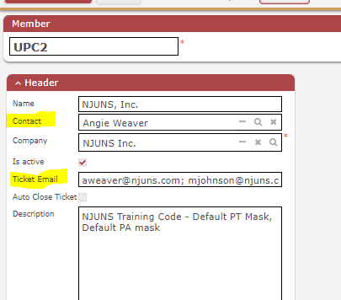
Member Codes
View codes in profile by clicking on Members (My Members)
Send any updates to support@njuns.com
Ticket email can have up to 4 email addresses. If blank, it will deactivate after several bounces.
Make sure Contact is correct

Slide 5
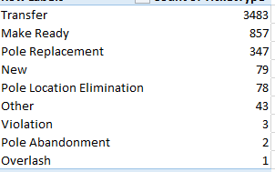
Ticket Types
See Ticket Type Definitions document under Training, Best Practices for help with deciding which to use.

Slide 6
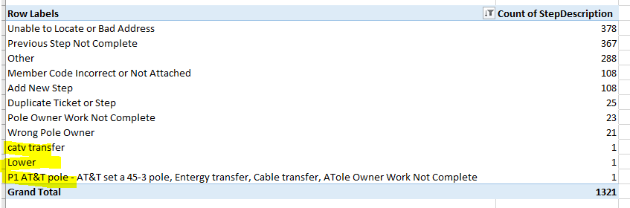
Steps
Approximately 1,321 active Dispute Steps
Why are tickets being disputed?
Make sure when choosing ‘Other’ there is not an option available.
The ones highlighted in yellow had description changed by creator or owner.

Slide 7
Short Demo
NJUNS Tips & Tricks
My Members Filter previously shown, can be used for Filters & Reports
Searching for multiple ticket numbers, saving to a set
Filtering a ticket list
Removing the counties filter so code can be typed in

Slide 8

Information
Available Training – visit training tab on www.njuns.com
Training calendar, User Guide, Training Videos, Best Practices documents
Pay attention to System Alerts
Visit News on our website for updates
Follow us on LinkedIn, Twitter, or Facebook

Slide 9
Questions
Any questions for us?
support@njuns.com

